Slide 1
Introduction to Computer Vision

Slide 2
Tentative Schedule
Introduction to Computer Vision
Theory of Neural Networks
Building a Neural Network in Keras
Introduction to CNN
Building a CNN in Keras
Introduction to YOLOv5
Using a pre-trained YOLOv5 model
Building a custom YOLOv5 model

Slide 3

Malaysia AI
Malaysia AI Projects, a repository to gather projects related to Malaysia from multiple domain such as Tabular, Image, Text and Audio.
Run by Husein Zolkepli & Khursani
Malaysia Artificial Intelligence · GitHub
https://malaysia-ai-projects.readthedocs.io/en/latest/

Slide 4
What is computer vision ?
Computer vision is a field of artificial intelligence (AI) that enables computers and systems to derive meaningful information from digital images, videos and other visual inputs
IBM

Slide 5
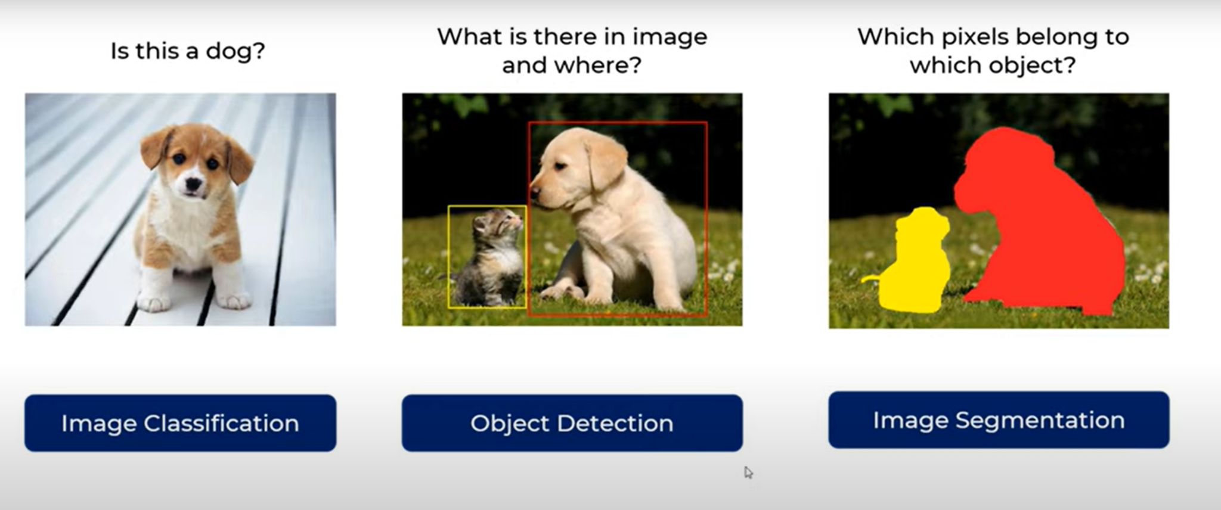
Types of Computer Vision
https://youtu.be/taC5pMCm70U

Slide 6
Applications of Computer Vision
Google Translate
Self Driving Car
Tracking of players in sports
Tracking of visitors in stores
Face ID
Defect Detection

Slide 7
Neural Networks

Slide 8

Neural Networks
But what is a neural network? | Chapter 1, Deep learning
CS231n Convolutional Neural Networks for Visual Recognition

Slide 9
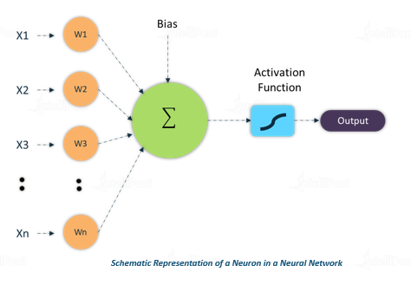
Neurons
Weights
Bias
Activation Function
https://intellipaat.com/community/253/role-of-bias-in-neural-networks

Slide 10
Neurons
Weights - The “amount of say” the input has. The higher the weight the more important the input.
Bias - Each neuron has its own bias.
Activation Function - A function which will decide whether the neuron is “active” or not.
Each feature will be multiplied by its own weight, then a bias function will be added to it ( Like linear regression y = mx+b). The result will then pass through an activation function. Collectively all the neurons will do this, each of them modifying the weights and biases with the goal of reducing the value of the loss function.

Slide 11
How it works? (Forward & Back Propagation)
Forward Propagation
The weights and biases of each neuron is randomly determined.
The whole dataset is fed into the neural network.
Everytime a data is fed a prediction is made.
The prediction is used to calculate the value of the loss function.
Back Propagation
The weights and biases of the neural network are adjusted, from the output layer towards the input layer.
A process of forward and back propagation for all the data is called an Epoch.

Slide 12
Loss Function
A Loss Function is a measure that is used to measure the effectiveness of our machine learning model.
In general, to measure the effectiveness of a machine learning model, the lower the loss function the better the model.
Similar to any other machine learning algorithms, the goal of a neural network is to reduce the value of its loss function.

Slide 13
Convolution Neural Networks

Slide 14
Convolution Neural Networks
For image recognition a classic ANN would not be suitable
Pixels would be treated independently
CNN builds filters which recognize features of image
Simple explanation of convolutional neural network | Deep Learning Tutorial 23 (Tensorflow & Python)

Slide 15
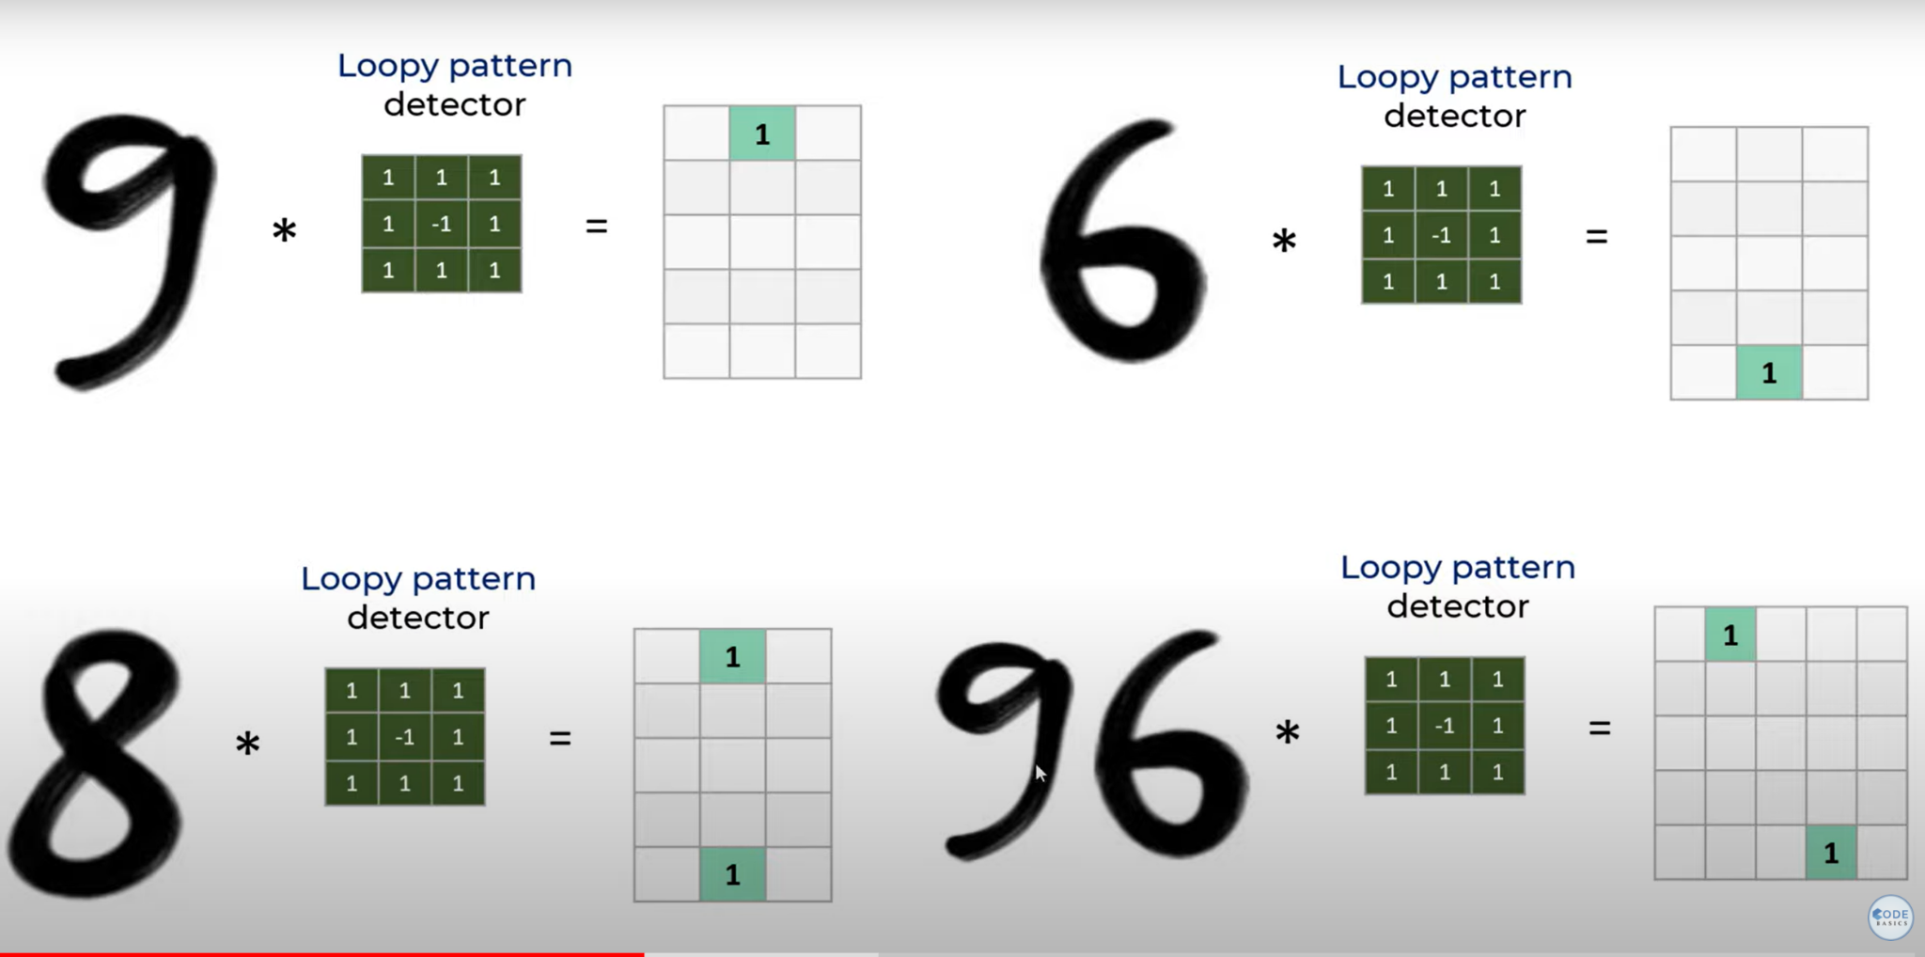
Convolution Neural Network
Simple explanation of convolutional neural network | Deep Learning Tutorial 23 (Tensorflow & Python)

Slide 16
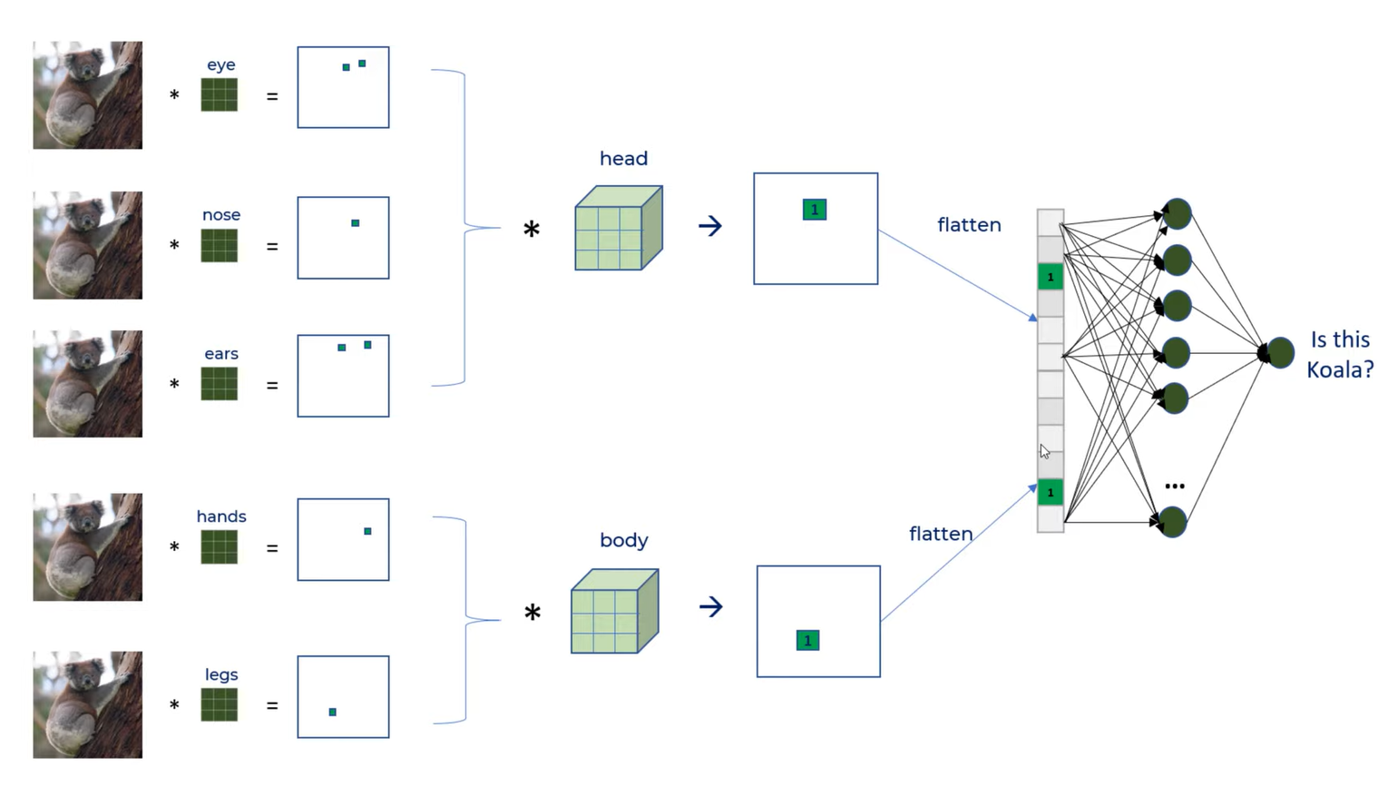
Convolution Neural Network

Slide 17
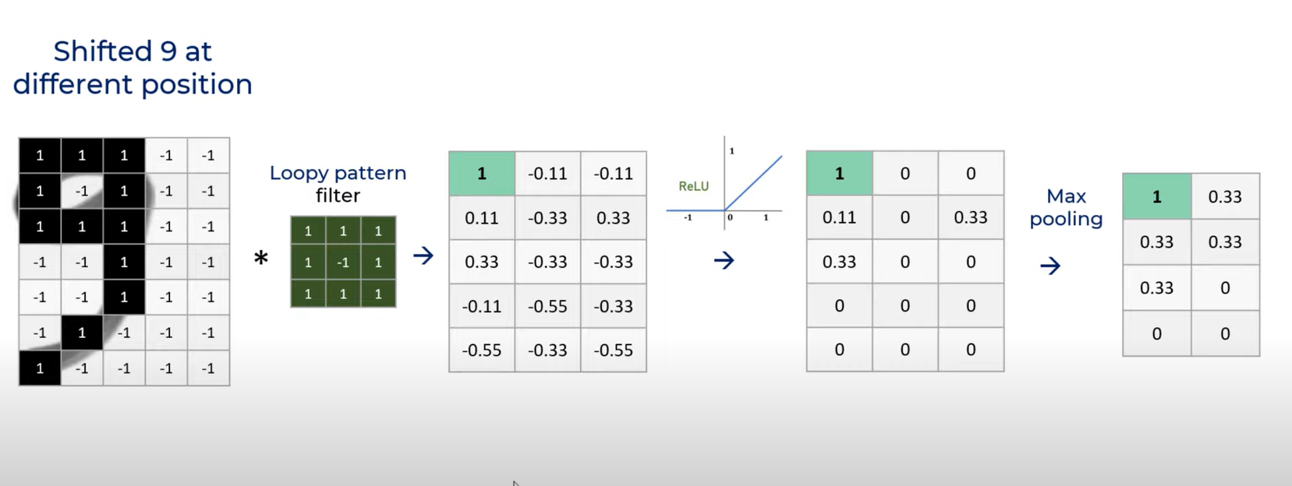
Convolution Neural Network

Slide 18
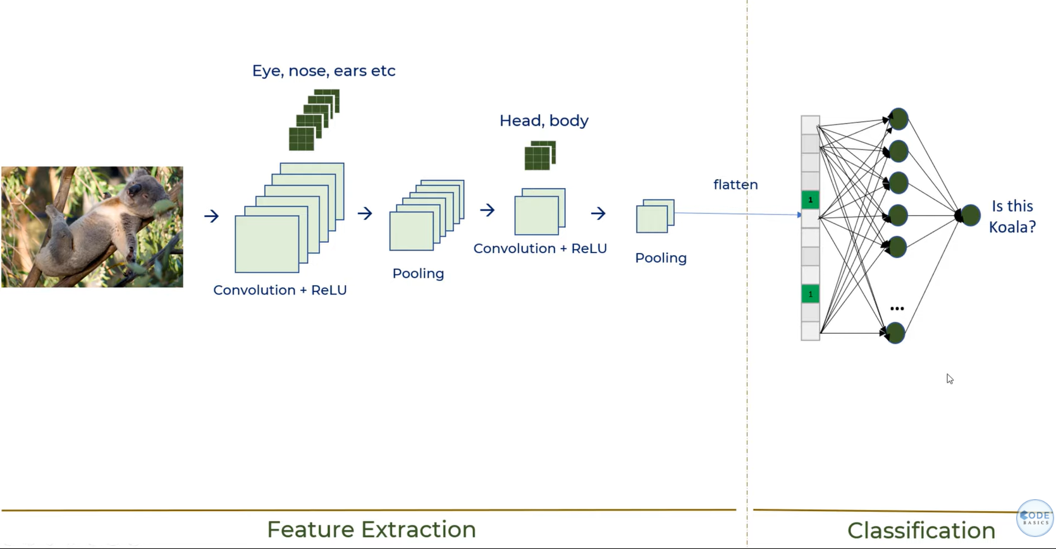
Convolution Neural Network

Slide 19
Benefits of CNN
Connection sparsity (local patches of pixels) reduces overfitting **still not very clear
Conv + Pooling gives location invariant feature detection ( recognize features regardless of location)
Parameter sharing - learn parameters for a feature can be share throughout image

Slide 20
MNIST Dataset
By Yann Lecun ( 1998 )
MNIST handwritten digit database, Yann LeCun, Corinna Cortes and Chris Burges
28 x 28 pixels = 784 values
Gray scale values 0-255
0 means background (white), 255 means foreground (black).

Slide 21
Keras Layers explanation
Conv2D - Run through the image and obtain features from image
Maxpool- Obtain the maximum value from the Conv2 kernel
Dropout - input to the dropout layer is set to zero for training. This is done to reduce overfitting
Activation Function - Function attached to each neuron in the network, and determines whether it should be activated (“fired”) or not.
Flatten - Makes data into 1 dimension
Dense - Fully connected layers of neural network
Computer vision with keras - YouTube
Convolutional Neural Networks Explained — How To Successfully Classify Images in Python | by Saul Dobilas | Towards Data Science

Slide 22
YOLO
( You Only Look Once )

Slide 23
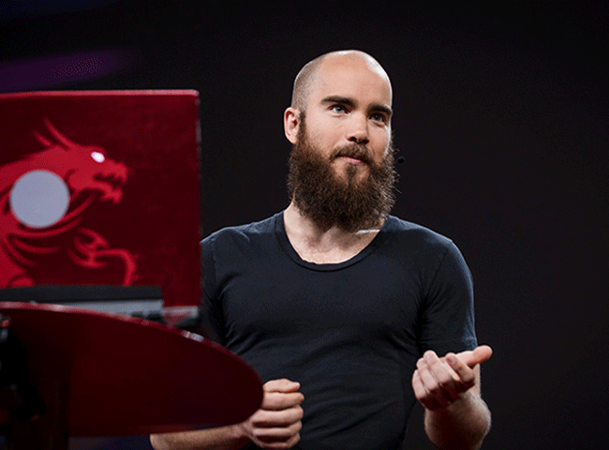
YOLO Brief History & Controversy ?
You Only Look Once
Researched mainly by Joseph Redmond up to YOLOv3 .
Joseph Redmond quits due to ethical concerns
YOLOv4 & above forked from YOLOv3 and further developed
Glenn Jocher (Ultralytics) released YOLOv5
Build on top of Pytorch not Darknet framework
How computers learn to recognize objects instantly | Joseph Redmon
Notes:
(1) he is not an original YOLO author, (2) he did not publish a paper, and/or (3) the implementation is not sufficiently novel.
YOLO v5 is different from all other prior releases, as this is a PyTorch implementation rather than a fork from original Darknet. Same as YOLO v4, the YOLO v5 has a CSP backbone and PA-NET neck. The major improvements includes mosaic data augmentation and auto learning bounding box anchors.

Slide 24
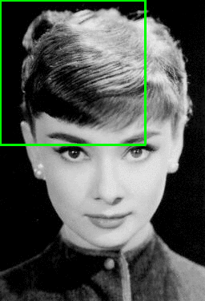
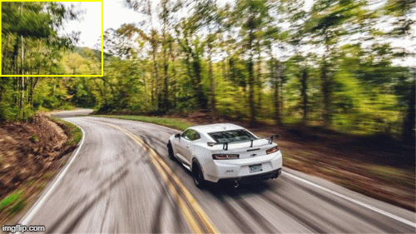
YOLO - How It Works
CNN - Sliding window
YOLO - Sliding window
YOLO— Real-Time Object Detection. A simplified explanation of the… | by Prateek Karkare | AI Graduate | Medium
Sliding windows | Computer Vision

Slide 25
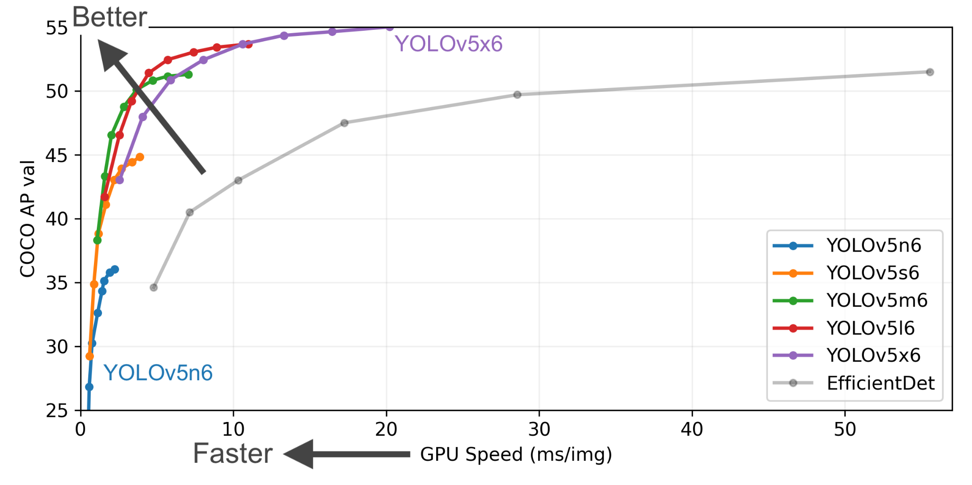
YOLOv5 Performance
https://github.com/ultralytics/yolov5

Slide 26
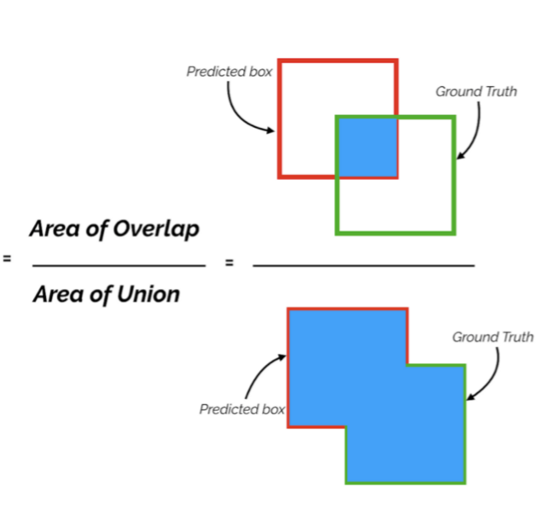
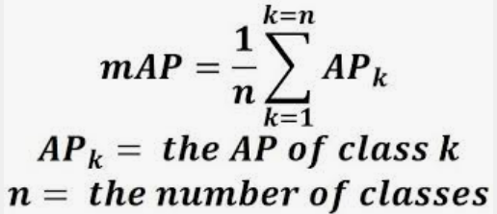
How do we know if our model is good ?
Intersection over Union (IoU) (Jaccard Index)
Similarity between the ground truth bounding box with the predicted bounding box
Precision
Predicted bounding box matches actual ground truth TP /(TP+FP)
Recall
Ground truth object being correctly detected TP/(TP + FN)
Mean average precision (mAP)
mAP (mean Average Precision) might confuse you! | by Shivy Yohanandan | Towards Data Science
Mean Average Precision (mAP) Explained: Everything You Need to Know
Evaluating Object Detection Models: Guide to Performance Metrics | Manal El Aidouni

Slide 27
Thank You !

Slide 28
References
https://analyticsindiamag.com/yolo-creator-joe-redmon-computer-vision-research-ethical-concern/
https://blog.roboflow.com/yolov4-versus-yolov5/
https://towardsdatascience.com/yolo-v4-or-yolo-v5-or-pp-yolo-dad8e40f7109
https://www.saashub.com/compare-pytorch-vs-darknet
https://youtu.be/JzHNIcvpGk8
https://www.youtube.com/watch?v=ag3DLKsl2vk&ab_channel=codebasics

